Slide 1
IST 625 – Enterprise Risk management SPARKCHARGE
Aditi Chawla
Anuj Jain
Edriss Waizi
Haykaz Bagratyan

Slide 2
Agenda
Enterprise Risk Management Framework
Company Overview
Interviews and site visits
Organizational Assessment & Risk Culture
Risk Identification Methods
Qualitative Risk Measurement
Top 5 risks
Risk Indicators, Risk Management, contingency planning and disaster recovery

Slide 3
Enterprise Risk Management Framework
Organizational
Assessment & Risk Culture
Risk Infrastructure/ governance
Risk Identification
Risk Measurement
and Indicators
Risk Management
Contingency Planning
& Disaster Recovery Planning

Slide 4
Company Overview
Founded in 2013
Mission: Ending range anxiety for electric vehicle owners
The first portable fast modular charging station with Level 3 charging
Undergoing acceleration program at “Techstars” (Boston), formerly part of Blackstone Launchpad
Design built on a modular approach
Releases this December
Notes:
The company aims to enhance the electric vehicle experience, by solving range anxiety, defined per the website as the fear “of an electric vehicle owner of not having enough battery range to make it from point A to point B”. Sparkcharge developed a portable charging unit that can give consumers 10 miles of portable battery range.

Slide 5
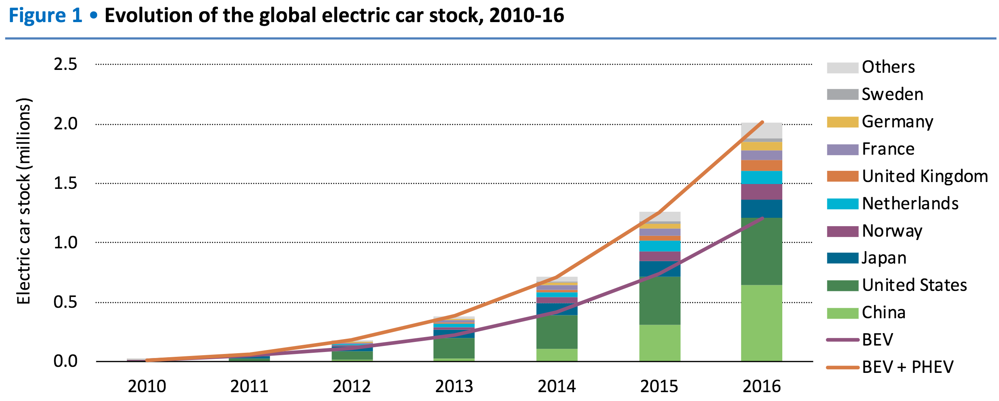
Industry Overview
2.5 million EVs worldwide
Growth 80% per year
More than 40% of EVs in US
Growth facilitated by government policies

Slide 6
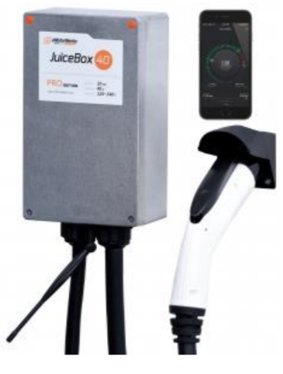
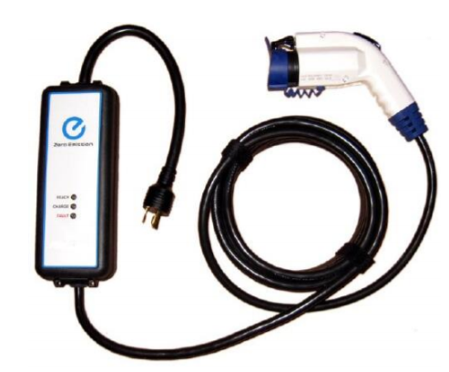

Level 1
Level 3
Level 2

Slide 7
Interview and site visits
February 26th, 2018 - Interview with Blackstone Launchpad Program Manager for industrial risk analysis, general startup risks and risk culture at Sparkcharge ( Braden Croy, Anuj Jain, Haykaz Bagratyan, Aditi Chawla, Edriss Waizi )
March 31st, 2018 - Interview with the CEO of Sparkcharge for a comprehensive interview regarding the company risk infrastructure, competitor analysis ( Joshua Aviv, Haykaz Bagratyan, Anuj Jain, Aditi Chawla, Edriss Waizi)

Slide 8
Organizational Assessment & Risk Culture
No Enterprise Risk Management Framework
Approach to risk management: Fragmented, Ad hoc
Risk Appetite: High risk appetite due hi-tech nature of the business
Each of the personnel is held accountable for the risks of their respective areas
Requirements: A continuous and integrated ERM paradigm

Slide 9
Risk Identification Methods
SWOT Analysis
Interview
Brainstorming
Porter's Five Forces

Slide 10
SWOT Analysis
STRENGTHS (+)
WEAKNESSES (–)
Highly innovative product (10x fast charging)
Skilled workforce with 90% engineers
Partnership with established companies like LG
High focus on operational factors(outsource financial management, in house marketing)
No data on similar products
Leaders with less industry experience
No ERM Framework
OPPORTUNITIES (+)
THREATS (–)
Increasing popularity of sustainable energy
Capitalization on first movers advantage
Open market with less competition
Rapidly growing market
Partnerships with automotive industry companies for product sales
Dependence on one external party for supply chain
Uncertain consumer behavior
Failure to meet target deadlines
Threat of new market entrants
Indirect competition- no need for portable charging devices
Pricing inefficiency

Slide 11
Porter’s Five Forces
Character of Rivalry: High Ever changing technology forces high competition
Barriers to Entry: High High start-up costs High learning curve
Threat of Substitutes: Low Other options not as energy dense or cost effective
Supplier Power: Medium
Few lithium suppliers Technical parts can be shuffled at low cost
Buyer Power: Low
High cost of switching Not price sensitive

Slide 12
Risk Identified
Risk | Identification Technique
Functional Risk | Brainstorming
Demand Risk | Brainstorming
Talent Management Risk | Interview
Team Risk | Interview
Regulatory Risk | Interview
Technology Risk | Porter's 5
Market Penetration Risk | Porter's 5
Competitive Risk | Porter's 5
Supply Chain Risk | SWOT
Capital Risk | SWOT
Notes:
does not meet the expectations of customers
Difference between talent management and team risks: The HR team fails to manage the workforce and team risk is co founders go apart. They don’t agree with each other

Slide 13
Risks Measured
 | Risk | Identification Technique | Likelihood | Impact
1 | Functional Risk | Brainstorming | Low | Moderate
2 | Demand Risk | Brainstorming | Moderate | High
3 | Talent Management Risk | Interview | Low | Moderate
4 | Team Risk | Interview | Moderate | High
5 | Regulatory Risk | Interview | Low | Moderate
6 | Technology Risk | Porter's 5 | High | High
7 | Market Penetration Risk | Porter's 5 | Moderate | High
8 | Competitive Risk | Porter's 5 | Low | Moderate
9 | Supply Chain Risk | SWOT | Low | Moderate
10 | Capital Risk | SWOT | High | High

Slide 14
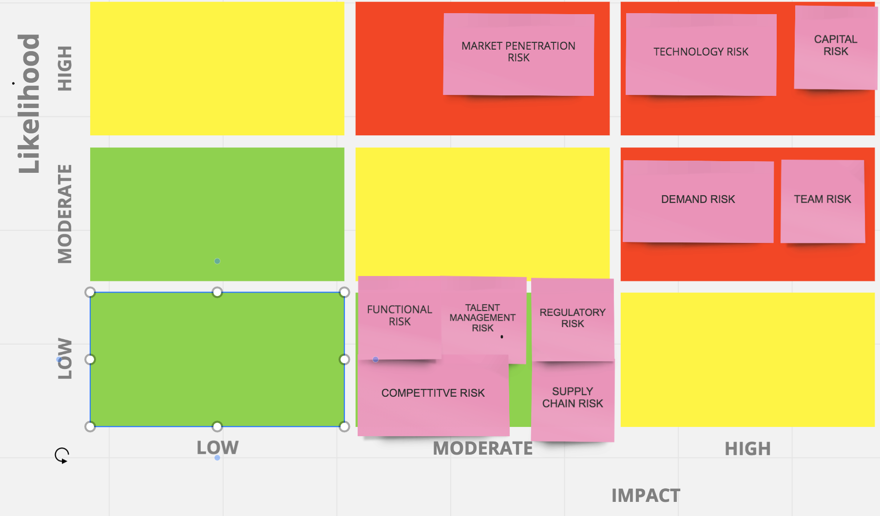
Risks Mapped

Slide 15
Top 5 Risks
Technology Risk
Team Risk
Demand Risk
Market Penetration Risk
Capital Risk

Slide 16
Technology Risk
Indicators
R&D Breakthrough on a New Battery Technology
Customer reports battery failures
Risk Management
Quality Assurance Team
Rigorous testing
Scenario Analysis
Keep the company aware of trends and R&D in the industry
Contingency Plan
Multiple teams working on the same idea with different approach
Differentiation strategy change (example: pricing)
Steal the technology
Disaster recovery
Hiring new engineers based on expert analysis
Acquiring similar technology

Slide 17
Team Risk
Indicators
Strong conceptual disagreements
Dip in group performance
Risk Management
Develop a conflict resolution framework
Contingency Plan
Mediation by an external expert
Disaster Recovery Plan
Buy-out clauses between partners/co-founders
Notes:
It is the risk of co-founders and the executive board members not being on the same page.
Rivalry between engineers and the management board.
Conflict resolution framework (external and internal ) – arbitration, mediation and negotiation

Slide 18
Demand Risk
Indicators
Sales strongly below forecast
Risk Management
Having a thorough market analysis
Focus groups
Contingency Planning
Promotional deals with institutions
Disaster recovery
Product pivoting
Target market change(New research)
Get yourself acquired

Slide 19
Market Penetration Risk
Indicators:
A survey indicating awareness about product not as expected in the group targeted by marketing
Risk Management
Viral marketing. Maybe send Elon Musk one and bill him so that he can whine about it on his Instagram
Partnership (ex. EV dealerships)
Contingency Plan
Reassess marketing strategy
Outsource marketing
Disaster Recovery
Promotions (ex. Discounts)

Slide 20
Capital Risk
Indicators:
Missing milestone deadline
Perception of VCs about markets
Overall economy
Risk Management
Improve product pricing to increase cost efficiency
Improve company’s access to capital/cash
Improve planning and execution
Contingency Plan
SBA Government loan
Disaster Recovery
Limit market capitalization
Gain confidence of current and new venture capitalists

Slide 21
References
[1] Jar B, Watson N, Miller A(2016). “Rapid EV Chargers: Implementation of a Charger” EEA Conference & Exhibition 2016, 22 - 24 June, Wellington.
[2] Chynoweth, J., Chung, C., Qiu, C., Chu, P., & Gadh, R. (2014). Smart electric vehicle charging infrastructure overview. Isgt 2014. doi:10.1109/isgt.2014.6816440
[3]Retrieved from http://jes.ecsdl.org/content/164/1/A5019.full
[4]Retrieved from https://data.bloomberglp.com/bnef/sites/14/2017/07/BNEF-Lithium-ion-battery-costs-and-market.pdf
[5]Retrieved from https://www.researchandmarkets.com/research/7d6vwf/19_96_billion?w=4
[6]Retrieved from http://docketpublic.energy.ca.gov/PublicDocuments/17-IEPR-07/TN217132_20170417T164544_Global_EV_trends_and_forecast.pdf
[7]Retrieved from https://www.ntsb.gov/news/events/Documents/2013_Lithium_Batteries_FRM-Panel2e-Wilson.pdf
[8]Retrieved from https://www.forbes.com/sites/groupthink/2016/12/14/why-patents-should-be-part-of-every-startups-risk-mitigation-strategy/#5b0338701af6
[9]Retrieved from https://spcev.com
[10] Retrieved from https://fundingsage.com/14-startup-risks-entrepreneurs-should-consider-2/

